Slide 1
The Creation of the First Computer
A Journey Through the Evolution of Computing

Slide 2
Introduction
A Brief Overview
The creation of the first computer was a monumental achievement in the history of technology.
It paved the way for the digital revolution that has transformed the world we live in today.
This presentation will take you on a journey through the evolution of computing and the key milestones in the development of the first computer.

Slide 3
Pre-Computer Era
From Abacus to Analytical Engines
Before the creation of the first computer, humans relied on manual computation devices such as the abacus and slide rules.
However, in the 19th century, inventors like Charles Babbage and Ada Lovelace conceptualized the idea of analytical engines, which laid the foundation for modern computers.
These early machines were mechanical, and they used punch cards to perform calculations.

Slide 4
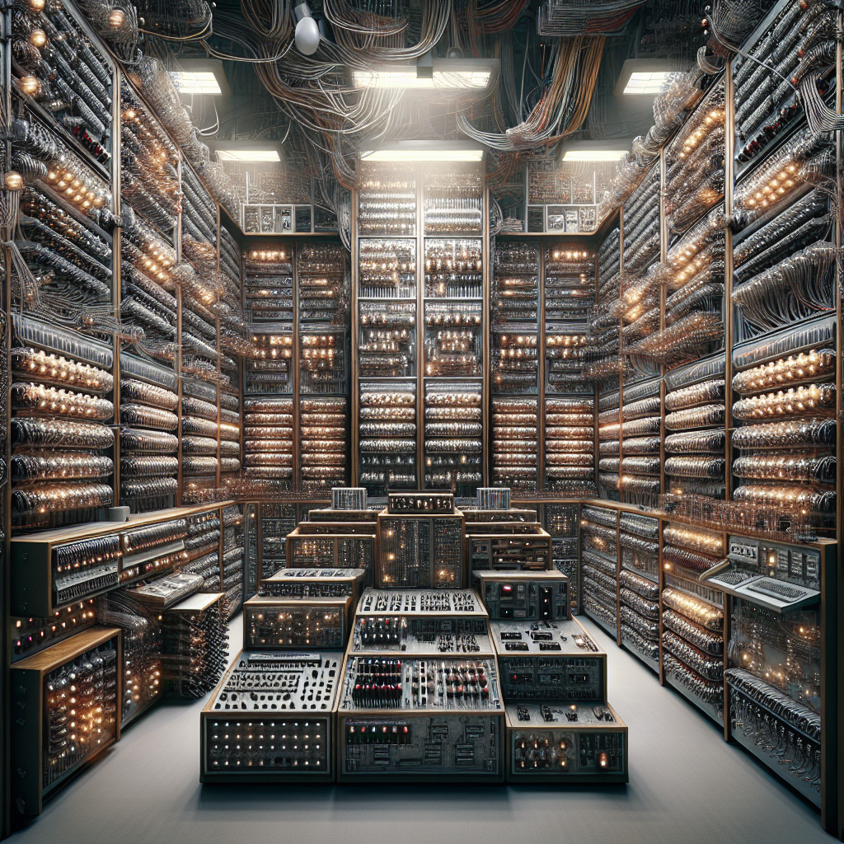
The First Electronic Computer
A Revolutionary Breakthrough
The first electronic computer, known as ENIAC (Electronic Numerical Integrator and Computer), was created in the 1940s.
It was a massive machine that occupied an entire room and used vacuum tubes to perform calculations.
ENIAC marked a significant shift from mechanical to electronic computing, and it laid the groundwork for the development of modern computers.
ENIAC

Slide 5
Transistors and Integrated Circuits
Miniaturization and Increased Processing Power
In the 1950s and 1960s, the invention of transistors and integrated circuits revolutionized computing.
Transistors replaced vacuum tubes, making computers smaller, more reliable, and energy-efficient.
Integrated circuits further miniaturized components and increased processing power, leading to the development of mainframe computers and eventually personal computers.

Slide 6
Microprocessors and Personal Computers
The Birth of the PC Era
The invention of microprocessors in the 1970s paved the way for the development of personal computers.
Companies like Apple and IBM introduced the first desktop computers, making computing accessible to individuals and revolutionizing industries.
The PC era marked a shift from large, centralized computing systems to decentralized personal computing.

Slide 7
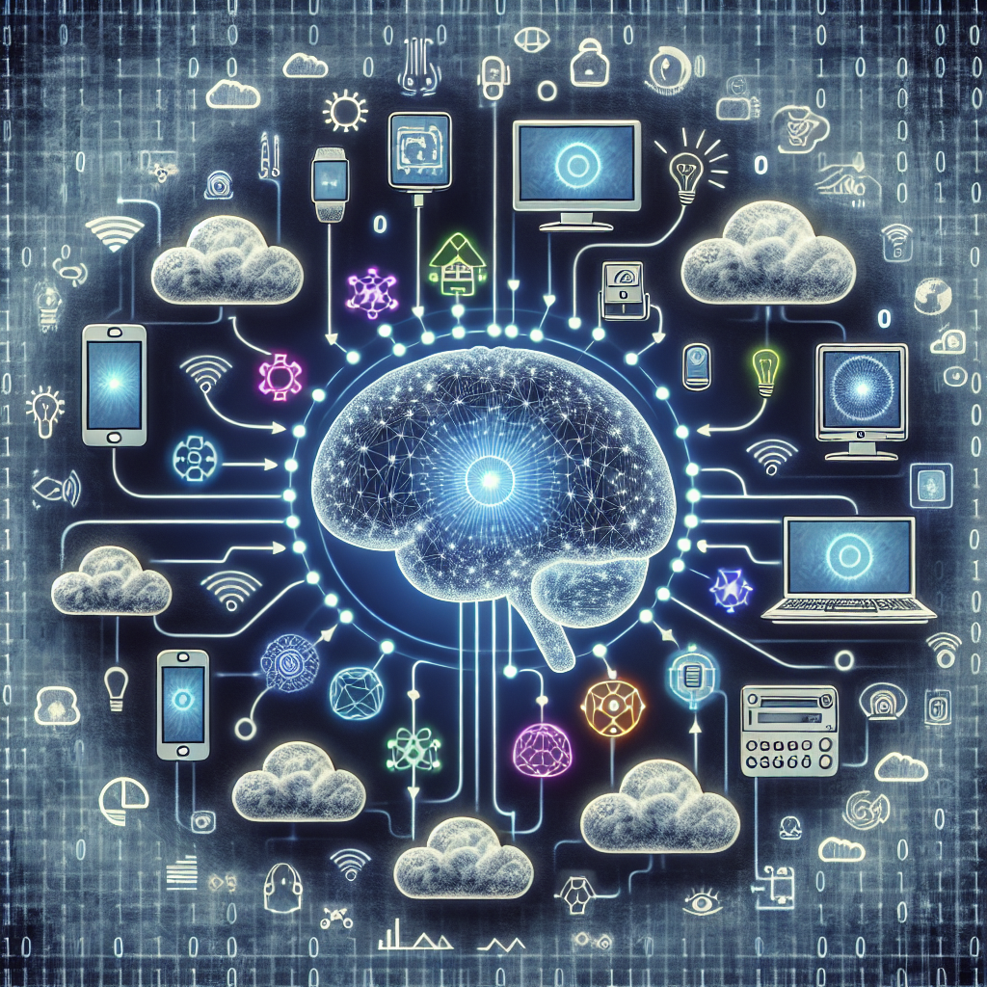
Advancements in Computing
Beyond Personal Computers
Since the creation of the first computer, computing technology has continued to evolve at a rapid pace.
Advancements such as artificial intelligence, the internet of things, and cloud computing have transformed the way we interact with technology.
These advancements have opened up new possibilities and continue to shape the future of computing.
Advancements in Computing

Slide 8
Conclusion
A Legacy of Innovation
The creation of the first computer marked the beginning of a journey that has revolutionized the world.
From mechanical devices to electronic computers and the rise of personal computing, we have come a long way.
The legacy of innovation in computing continues, and the future holds even more exciting possibilities.

Slide 9
References
Sources for Further Exploration
1. Ceruzzi, P. E. (2017). Computing: A concise history. MIT Press.
2. Campbell-Kelly, M. (2013). From air traffic control to airline reservations: a history of the computer (Vol. 1). Springer Science & Business Media.
3. Lavington, S. H. (2014). Early British computers: The story of vintage computers and the people who built them. Springer.

Slide 10
Thank You
Any Questions?
Thank you for your attention!
Feel free to ask any questions you may have.

